Slide 1
Lecture-3
Matrix Inverse using elementary row operation & System of Linear Equation

Slide 2
Objective:
How to find the inverse of a matrix
Discuss basic idea about System of linear equation
How to solve a system of linear equation
Methodology:
Find inverse using elementary row operation
Solve a system of linear equation using Gaussian elimination

Slide 3
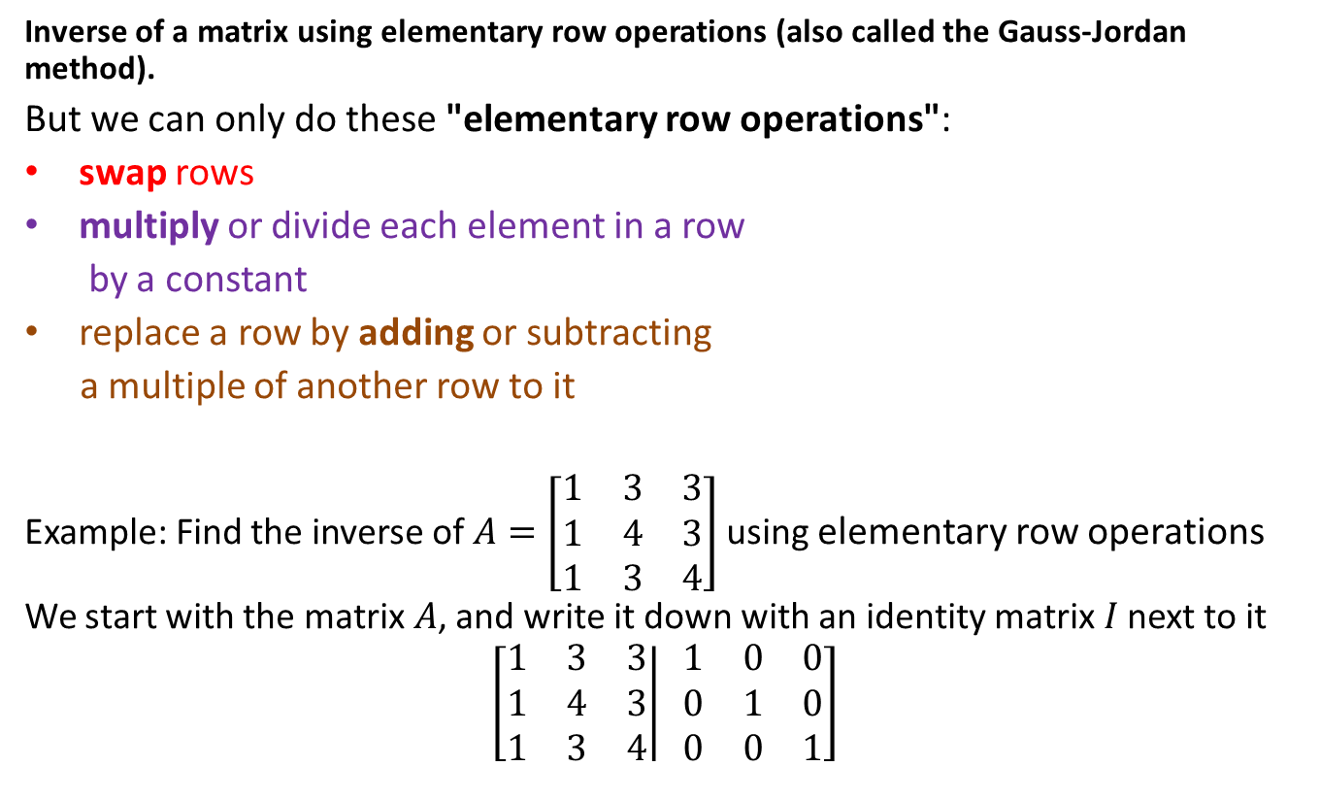
Inverse of a Matrix
Inverse of a matrix using elementary row operations (also called the Gauss-Jordan method).
But we can only do these "elementary row operations":
swap rows
multiply or divide each element in a row
by a constant
replace a row by adding or subtracting
a multiple of another row to it
Example: Find the inverse of $A=\left[\begin{matrix}1 & 3 & 3 \\ 1 & 4 & 3 \\ 1 & 3 & 4\end{matrix}\right]$ using elementary row operations
We start with the matrix $A$, and write it down with an identity matrix$I$ next to it
$$\left[\left.\begin{matrix}1 & 3 & 3 \\ 1 & 4 & 3 \\ 1 & 3 & 4\end{matrix}\right| \begin{matrix}1 & 0 & 0 \\ 0 & 1 & 0 \\ 0 & 0 & 1\end{matrix}\right]$$

Slide 4
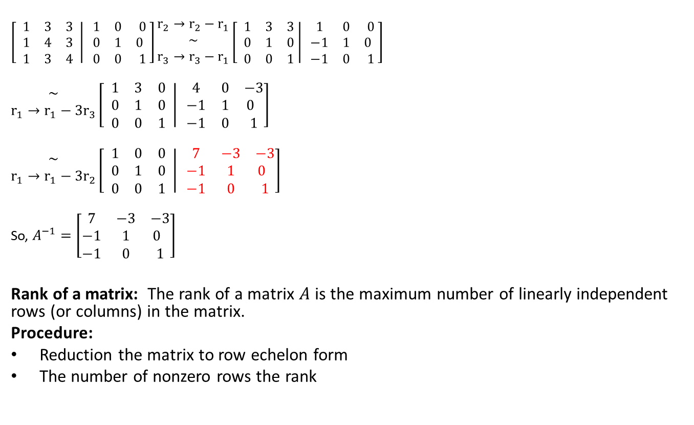
Inverse (Continued)
$\left[ \left.\begin{matrix}1 & 3 & 3 \\ 1 & 4 & 3 \\ 1 & 3 & 4\end{matrix} \right| \begin{matrix}1 & 0 & 0 \\ 0 & 1 & 0 \\ 0 & 0 & 1\end{matrix}\right]\begin{matrix}r_{2}→r_{2}−r_{1} \\ \sim \\ r_{3}→r_{3}−r_{1}\end{matrix}\left[ \left.\begin{matrix}1 & 3 & 3 \\ 0 & 1 & 0 \\ 0 & 0 & 1 \end{matrix}\right| \begin{matrix}1 & 0 & 0 \\ −1 & 1 & 0 \\ −1 & 0 & 1\end{matrix}\right]$
$\begin{matrix}\sim \\ r_{1}→r_{1}−{3r}_{3}\end{matrix}\left[ \left.\begin{matrix}1 & 3 & 0 \\ 0 & 1 & 0 \\ 0 & 0 & 1\end{matrix} \right| \begin{matrix}4 & 0 & −3 \\ −1 & 1 & 0 \\ −1 & 0 & 1\end{matrix}\right]$
$\begin{matrix}\sim \\ r_{1}→r_{1}−{3r}_{2}\end{matrix}\left[ \left.\begin{matrix}1 & 0 & 0 \\ 0 & 1 & 0 \\ 0 & 0 & 1\end{matrix} \right| \begin{matrix}7 & −3 & −3 \\ −1 & 1 & 0 \\ −1 & 0 & 1\end{matrix}\right]$
So, $A^{−1}=\left[\begin{matrix}7 & −3 & −3 \\ −1 & 1 & 0 \\ −1 & 0 & 1\end{matrix}\right]$
Rank of a matrix: The rank of a matrix $A$ is the maximum number of linearly independent rows (or columns) in the matrix.
Procedure:
Reduction the matrix to row echelon form
The number of nonzero rows the rank
.

Slide 5
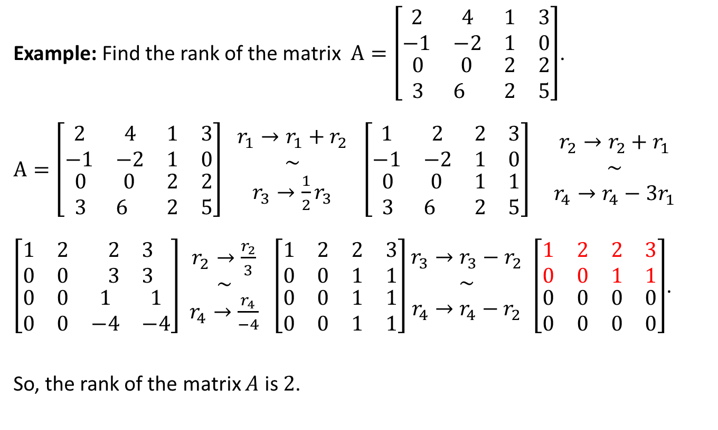
Rank
Example: Find the rank of the matrix $A=\left[\begin{matrix}\begin{matrix}2 & 4 \\ −1 & −2\end{matrix} & \begin{matrix}1 & 3 \\ 1 & 0\end{matrix} \\ \begin{matrix}0 & 0 \\ 3 & 6\end{matrix} & \begin{matrix}2 & 2 \\ 2 & 5\end{matrix}\end{matrix}\right]$.
$A=\left[\begin{matrix}\begin{matrix}2 & 4 \\ −1 & −2\end{matrix} & \begin{matrix}1 & 3 \\ 1 & 0\end{matrix} \\ \begin{matrix}0 & 0 \\ 3 & 6\end{matrix} & \begin{matrix}2 & 2 \\ 2 & 5\end{matrix}\end{matrix}\right]$ $\begin{matrix}r_{1}→r_{1}+r_{2} \\ \sim \\ r_{3}→\frac{1}{2}r_{3}\end{matrix}$ $\left[\begin{matrix}\begin{matrix}1 & 2 \\ −1 & −2\end{matrix} & \begin{matrix}2 & 3 \\ 1 & 0\end{matrix} \\ \begin{matrix}0 & 0 \\ 3 & 6\end{matrix} & \begin{matrix}1 & 1 \\ 2 & 5\end{matrix}\end{matrix}\right]$ $\begin{matrix}r_{2}→r_{2}+r_{1} \\ \sim \\ r_{4}→r_{4}−3r_{1}\end{matrix}$
$\left[\begin{matrix}\begin{matrix}1 & 2 \\ 0 & 0\end{matrix} & \begin{matrix}2 & 3 \\ 3 & 3\end{matrix} \\ \begin{matrix}0 & 0 \\ 0 & 0\end{matrix} & \begin{matrix}1 & 1 \\ −4 & −4\end{matrix}\end{matrix}\right]$ $\begin{matrix}r_{2}→\frac{r_{2}}{3} \\ \sim \\ r_{4}→\frac{r_{4}}{−4}\end{matrix}$ $\left[\begin{matrix}\begin{matrix}1 & 2 \\ 0 & 0\end{matrix} & \begin{matrix}2 & 3 \\ 1 & 1\end{matrix} \\ \begin{matrix}0 & 0 \\ 0 & 0\end{matrix} & \begin{matrix}1 & 1 \\ 1 & 1\end{matrix}\end{matrix}\right]\begin{matrix}r_{3}→r_{3}−r_{2} \\ \sim \\ r_{4}→r_{4}−r_{2}\end{matrix}$ $\left[\begin{matrix}\begin{matrix}1 & 2 \\ 0 & 0\end{matrix} & \begin{matrix}2 & 3 \\ 1 & 1\end{matrix} \\ \begin{matrix}0 & 0 \\ 0 & 0\end{matrix} & \begin{matrix}0 & 0 \\ 0 & 0\end{matrix}\end{matrix}\right]$.
So, the rank of the matrix $A$ is $2$.

Slide 6
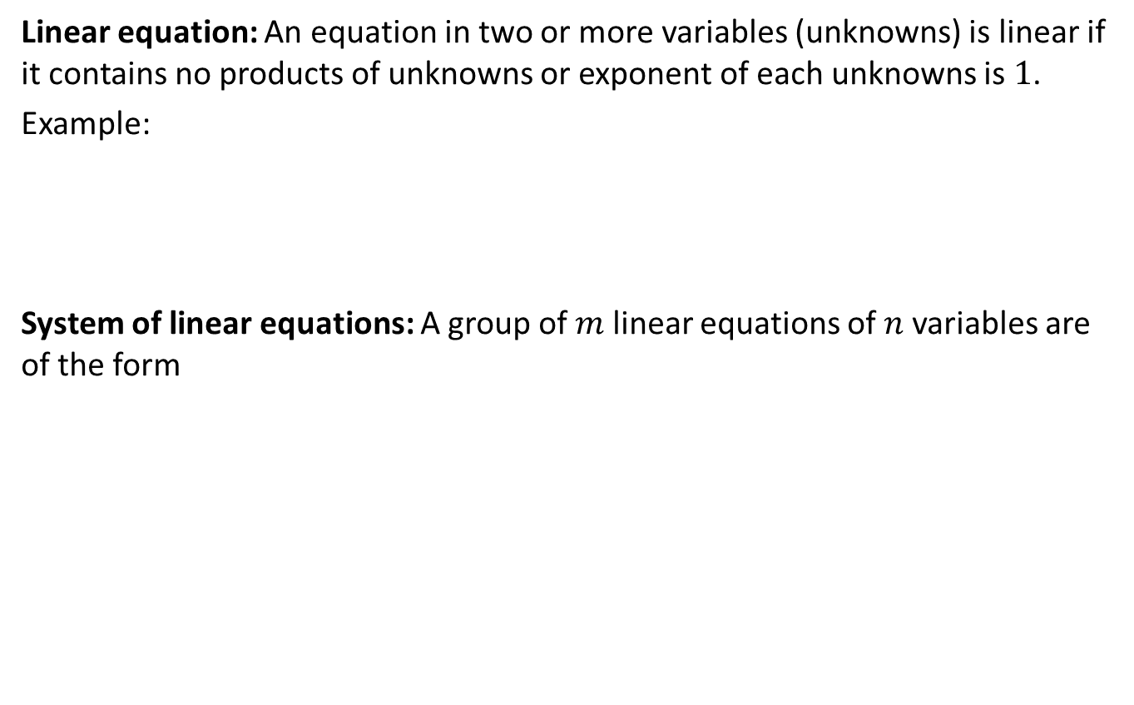
System of linear equation
Linear equation: An equation in two or more variables (unknowns) is linear if it contains no products of unknowns or exponent of each unknowns is $1$.
Example:
System of linear equations: A group of $m$ linear equations of $n$ variables are of the form

Slide 7
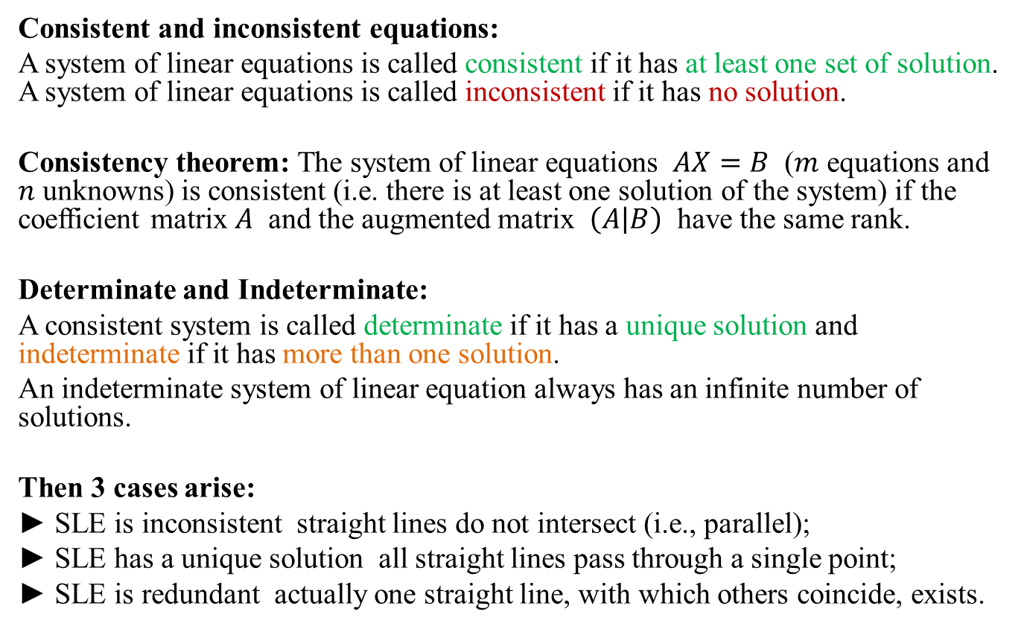
System of linear equation
Consistent and inconsistent equations:
A system of linear equations is called consistent if it has at least one set of solution. A system of linear equations is called inconsistent if it has no solution.
Consistency theorem: The system of linear equations $AX=B$ ($m$ equations and $n$ unknowns) is consistent (i.e. there is at least one solution of the system) if the coefficient matrix $A$ and the augmented matrix $\left(A | B\right)$ have the same rank.
Determinate and Indeterminate:
A consistent system is called determinate if it has a unique solution and indeterminate if it has more than one solution.
An indeterminate system of linear equation always has an infinite number of solutions.
Then 3 cases arise:
► SLE is inconsistent straight lines do not intersect (i.e., parallel);
► SLE has a unique solution all straight lines pass through a single point;
► SLE is redundant actually one straight line, with which others coincide, exists.

Slide 8
Methods of solving system of linear equation:
There are three commonly used methods to solve system of linear equations:
Using elementary row operations (Gaussian elimination and Gauss-Jordan elimination),
Using inverse matrix,
Cramer’s rule.

Slide 9
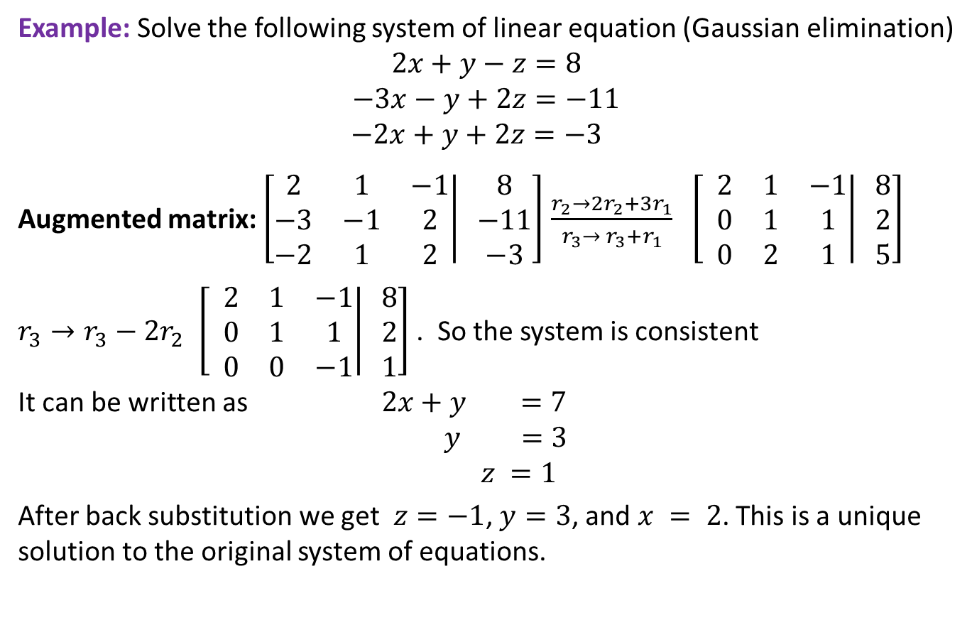
Unique Solution
Example: Solve the following system of linear equation (Gaussian elimination)
$$2x+y−z=8$$
$$−3x−y+2z=−11$$
$$−2x+y+2z=−3$$
Augmented matrix: $\left[\left.\begin{matrix}2 & 1 & −1 \\ −3 & −1 & 2 \\ −2 & 1 & 2\end{matrix}\right| \begin{matrix}8 \\ −11 \\ −3\end{matrix}\right]$ $\frac{r_{2}→{2r}_{2}+3r_{1}}{r_{3}→ r_{3}+r_{1}}$ $\left[ \left.\begin{matrix}2 & 1 & −1 \\ 0 & 1 & 1 \\ 0 & 2 & 1\end{matrix}\right| \begin{matrix}8 \\ 2 \\ 5\end{matrix}\right]$
$r_{3}→r_{3}−2r_{2}$ $\left[ \left.\begin{matrix}2 & 1 & −1 \\ 0 & 1 & 1 \\ 0 & 0 & −1\end{matrix}\right| \begin{matrix}8 \\ 2 \\ 1\end{matrix}\right]$ . So the system is consistent
It can be written as $2x+y =7$
$$y =3$$
$$z =1$$
After back substitution we get $z=−1$, $y=3$, and $x = 2$. This is a unique solution to the original system of equations.

Slide 10
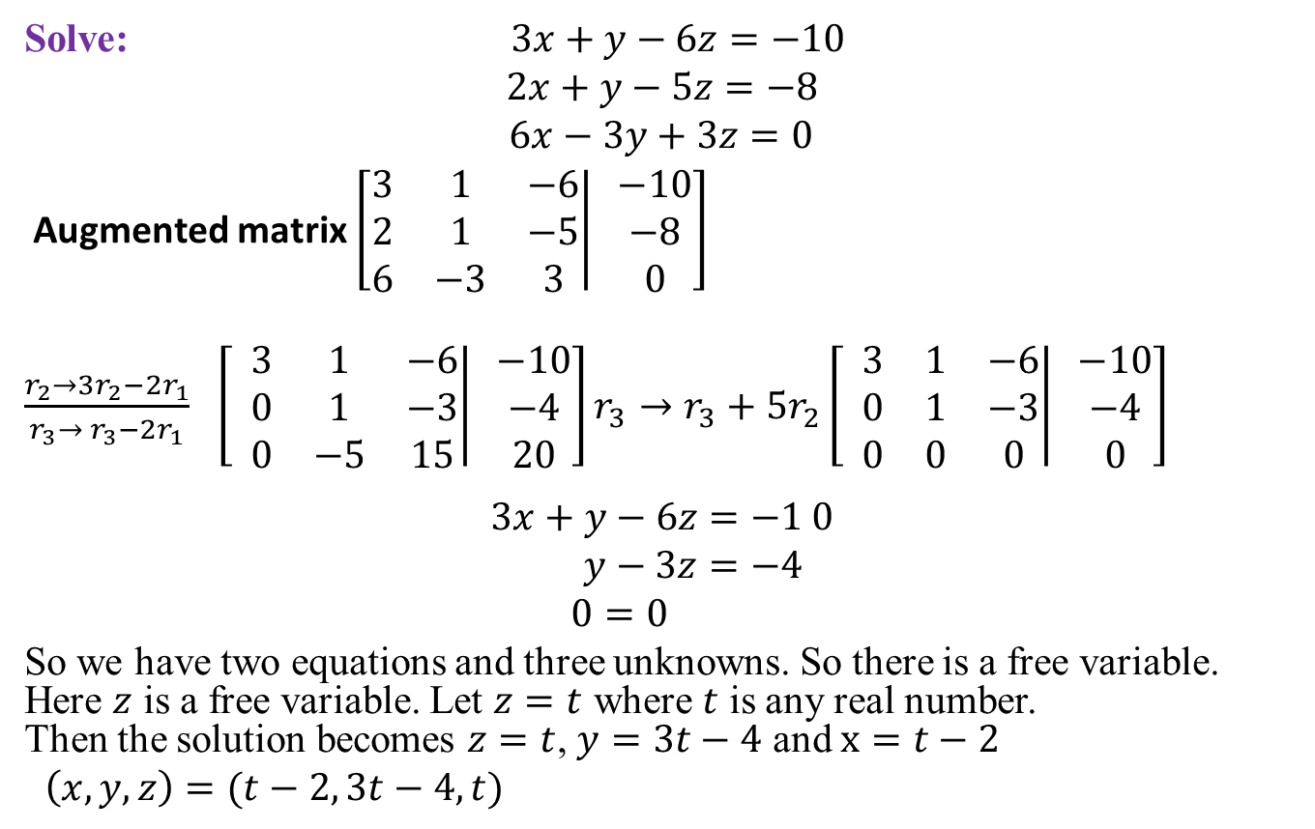
More than one Solution
Solve: $3x+y−6z=−10$
$$2x+y−5z=−8$$
$6x−3y+3z=0$
Augmented matrix $\left[\left.\begin{matrix}3 & 1 & −6 \\ 2 & 1 & −5 \\ 6 & −3 & 3\end{matrix}\right| \begin{matrix}−10 \\ −8 \\ 0\end{matrix}\right]$
$\frac{r_{2}→{3r}_{2}−2r_{1}}{r_{3}→ r_{3}−2r_{1}}$ $\left[ \left.\begin{matrix}3 & 1 & −6 \\ 0 & 1 & −3 \\ 0 & −5 & 15\end{matrix}\right| \begin{matrix}−10 \\ −4 \\ 20\end{matrix}\right]r_{3}→r_{3}+5r_{2}\left[ \left.\begin{matrix}3 & 1 & −6 \\ 0 & 1 & −3 \\ 0 & 0 & 0\end{matrix}\right| \begin{matrix}−10 \\ −4 \\ 0\end{matrix}\right]$
$$3x+y−6z=−1 0$$
$$y−3z=−4$$
$0=0$
So we have two equations and three unknowns. So there is a free variable. Here $z$ is a free variable. Let $z=t$ where $t$ is any real number. Then the solution becomes $z=t$, $y=3t−4$ and $x=t−2$
$\left(x,y,z\right)=(t−2, 3t−4,t)$

Slide 11
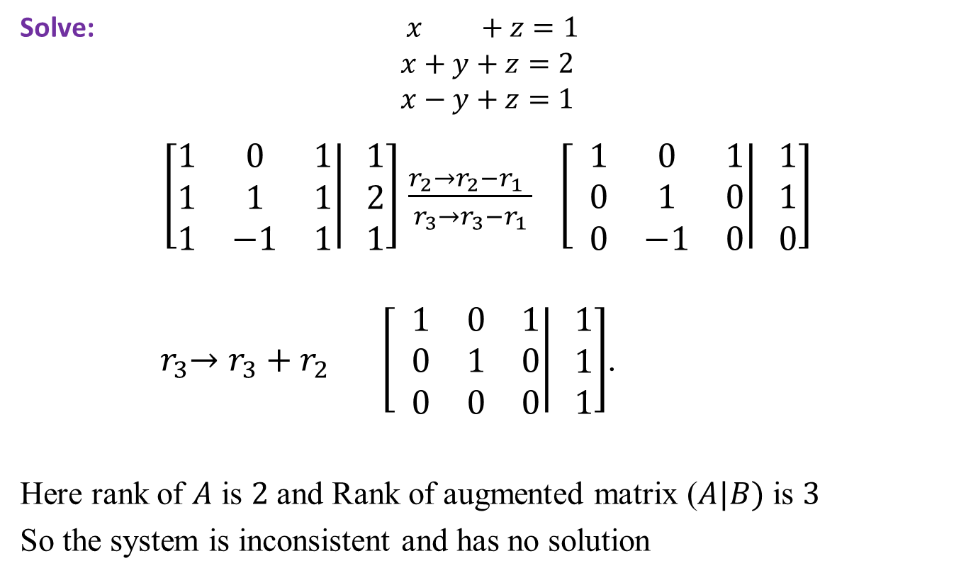
No Solution
Solve: $x +z=1$
$$x+y+z=2$$
$$x−y+z=1$$
$\left[\left.\begin{matrix}1 & 0 & 1 \\ 1 & 1 & 1 \\ 1 & −1 & 1\end{matrix}\right| \begin{matrix}1 \\ 2 \\ 1\end{matrix}\right]$ $\frac{r_{2}→r_{2}−r_{1} }{r_{3}→r_{3}−r_{1}}$ $\left[ \left.\begin{matrix}1 & 0 & 1 \\ 0 & 1 & 0 \\ 0 & −1 & 0\end{matrix}\right| \begin{matrix}1 \\ 1 \\ 0\end{matrix}\right]$
${ r}_{3}→r_{3}+r_{2} \left[ \left.\begin{matrix}1 & 0 & 1 \\ 0 & 1 & 0 \\ 0 & 0 & 0\end{matrix}\right| \begin{matrix}1 \\ 1 \\ 1\end{matrix}\right]$.
Here rank of $A$ is $2$ and Rank of augmented matrix ($A|B)$ is $3$
So the system is inconsistent and has no solution

Slide 12
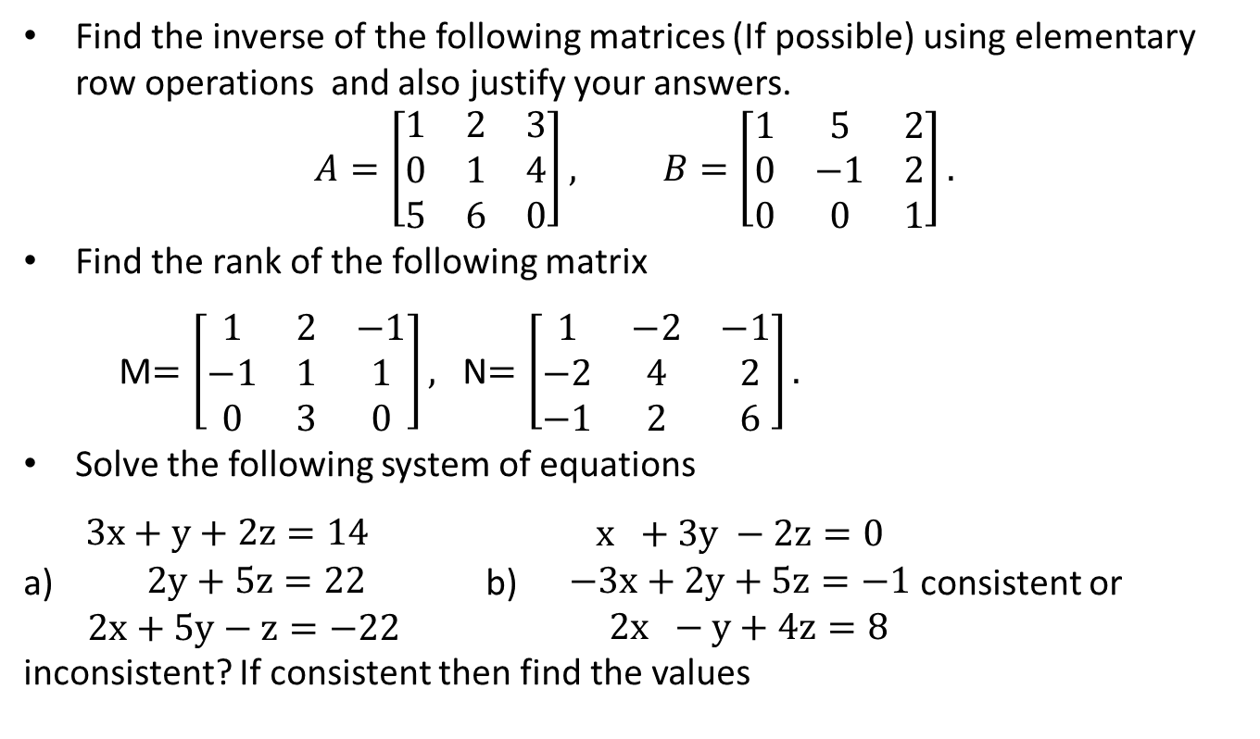
Sample Question
Find the inverse of the following matrices (If possible) using elementary row operations and also justify your answers.
$$A=\left[\begin{matrix}1 & 2 & 3 \\ 0 & 1 & 4 \\ 5 & 6 & 0\end{matrix}\right], B=\left[\begin{matrix}1 & 5 & 2 \\ 0 & −1 & 2 \\ 0 & 0 & 1\end{matrix}\right].$$
Find the rank of the following matrix
M$=\left[\begin{matrix}1 & 2 & −1 \\ −1 & 1 & 1 \\ 0 & 3 & 0\end{matrix}\right],$ N$=\left[\begin{matrix}1 & −2 & −1 \\ −2 & 4 & 2 \\ −1 & 2 & 6\end{matrix}\right].$
Solve the following system of equations
a)$\begin{matrix}3x+y+2z=14 \\ 2y+5z=22 \\ 2x+5y−z=−22\end{matrix}$b) $\begin{matrix} x +3y −2z=0 \\ −3x+2y+5z=−1 \\ 2x −y+4z=8\end{matrix}$ consistent or inconsistent? If consistent then find the values

Slide 13
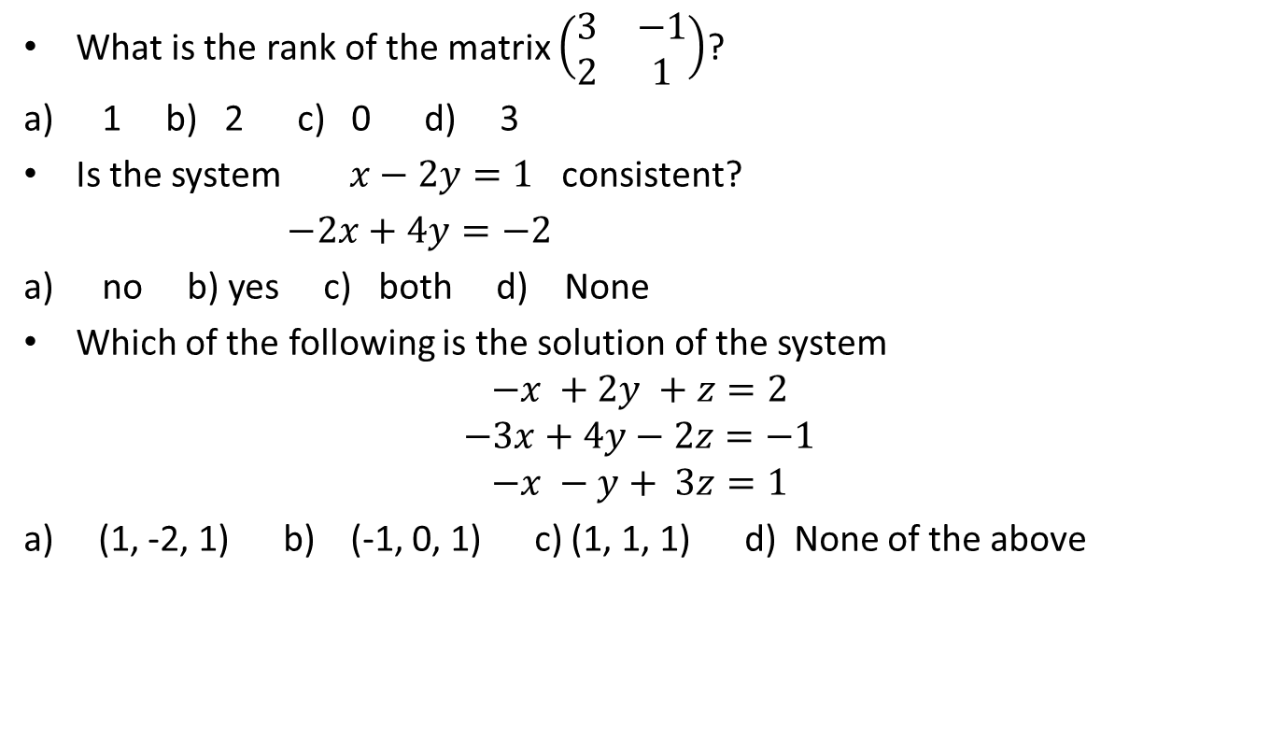
Sample MCQ
What is the rank of the matrix $\left(\begin{matrix}3 & −1 \\ 2 & 1\end{matrix}\right)$?
1 b) 2 c) 0 d) 3
Is the system $x−2y=1$ consistent?
$−2x+4y=−2$
no b) yes c) both d) None
Which of the following is the solution of the system
$$−x +2y +z=2$$
$$−3x+4y−2z=−1$$
$$−x −y+ 3z=1$$
a) (1, -2, 1) b) (-1, 0, 1) c) (1, 1, 1) d) None of the above

Slide 14
Outcome
After this lecture students
Will be able to find the inverse of a matrix using elementary row operation.
Will be able to calculate the rank of a matrix
Will know how to solve a system of equation.

Slide 15
Next class
Solution of system of linear equation using Cremer’s rule and matrix inverse method

